Slide 1


SMART INDIA
HACKATHON
2019
Ministry of
Railways
Problem Statement : De-duplication of Price List (PL) numbers
In some cases, same PL numbers has been allotted to multiple items and in other cases multiple PL numbers have been allotted to same items. An application need to be developed to make the data consistent.
Team Name : Tybom_2k19
College Name: Delhi Technological University

Slide 2
Initial Understanding
To solve above problem , we first find similarity in item descriptions to know similar items and then allot new PL Number to all them.
Different PL Numbers allotted to same items.
Centralised System lacks consistency due to:
Therefore, in both of the cases we need to design a formula for PL Number re-allotment.
To solve above problem , we need to assign new PL Number to each of the item.
Same PL Numbers allotted to different items.

Slide 3
Deviation
After studying the problem statement and dataset, we realised :
The system lacks a consistent nomenclature.
SOLUTION : We formed a reference database using PL Book that can be used to assign new PL Numbers.
Records that have unique PL Number and unique item description still follow old nomenclature ( Zonal ).
SOLUTION : Match item description of each entry with reference database and re- assign PL Number.
De-duplication of Price List (PL) numbers

Slide 4

Our Approach
Problems in Dataset
Same PL No
Different Description
Defining category and Sub category of items
Different PL No
Same Description
Alloting Serial No. to Pl No.
Centralized
Data
Consistent list of PL Numbers
Unique PL No
Unique Description
Standard Convention
Decentralized
Lists
Old Convention

Slide 5
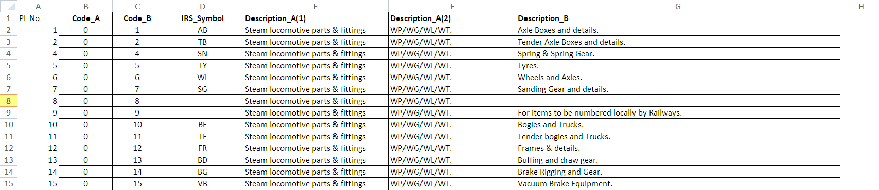
Reference Database
This database is created using PL Book available on Indian Railways Ministry website. It has around 3600 entries and is in accordance with the latest nomenclature.
Main Group
Sub-Group
Item Description

Slide 6
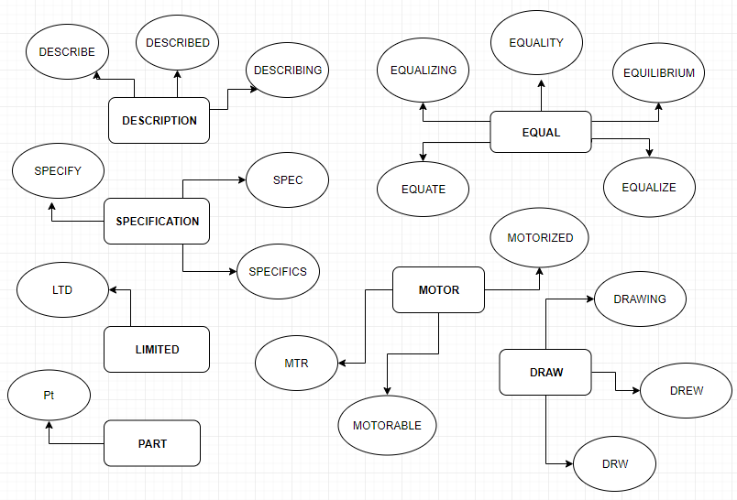
IMPLEMENTATION
IDENTIFICATION OF SYNTACTICALLY SIMILAR DESCRIPTIONS WITH DIFFERENT PL NUMBERS
Cases covered:
Spelling Errors
Lemmatization / Stemming
Different ordering of Words
Stop Words
Abbreviations
Upper / Lower cases
Statement 1: face linear motor part num dlg-256x175 meter
Statement 2: face lniear for in MOTor part num dlg-256x175 m
SIMILAR!
Natural Language (A)
Technical Description
(B)
Pre-process the
Statements and
Extract Tokens
No
No
Not Similar
Technical
Descriptions
are Equal
Yes
‘A’ parts are Syntactically Similar.
Yes
Similar

Slide 7
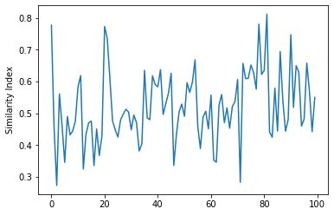
Implementation
Defining category and Sub category of items, With the help of Item description given to us.
Given Item List Description is compared with all the other Descriptions in PL book.
Following implementation is carried out with the help of Trained model developed using convulational neural network.
Alloting The Group with maximum Similarity Index to item

Slide 8
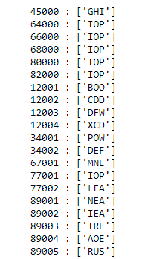
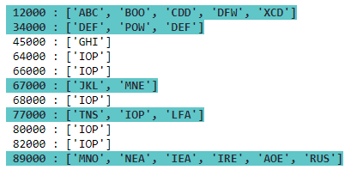
Implementation
Allotting serial numbers to the list of Items in same group number and same sub-groups.
This is done using a hexa-decimal encoding technique in contrast to the traditional use of only numbers.
Use of hexadecimal increases the data storing capacity of PL numbers by 40 times.
It can be extended further by changing the base. The base values may range from [10,36] depending upon our
future requirement.
Unique hexadecimal codes assigned to same groups and subgroups

Slide 9

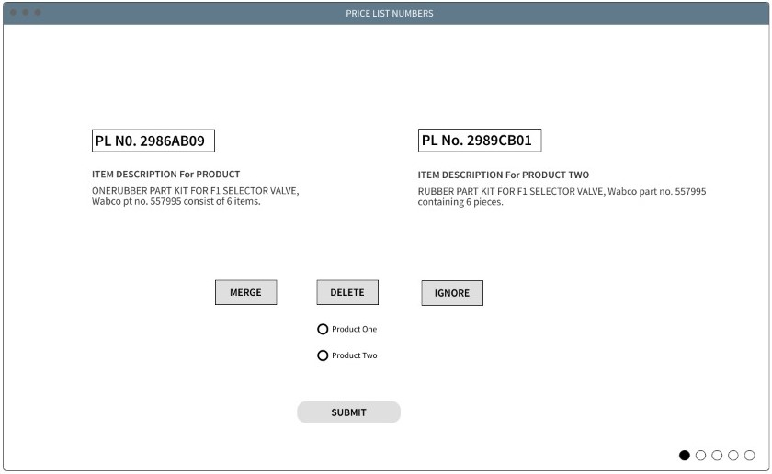


User-Interface
De-duplication of Price List (PL) numbers
Delete records
Ignore Suggestions
Merge records

Slide 10
Future Scope
Extensibility of system can be increased by changing the encoding criterion upto base 36.
To accommodate more items in system, we can also change the Main Group and Sub-group encoding to alpha-numeric.
A more interactive user-interface can be build which will provide user the options to merge / delete different records.

Slide 11
SMART INDIA
HACKATHON
2019
Ministry of
Railways
Tybom_2k19
“ Thank you ”

